Slide 1
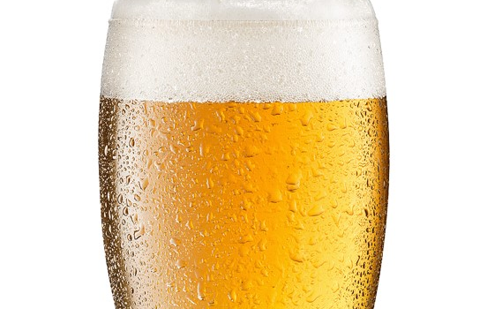
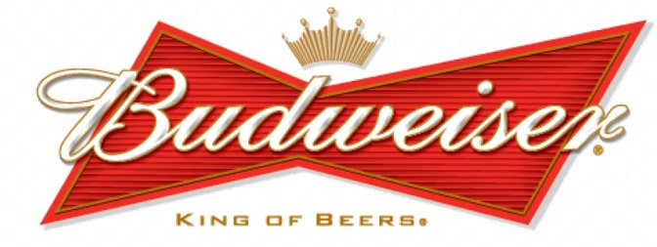
Statical Analysis Provided by
Always Analytics:
Nicole Assenza
Adam Vuinovic
April Erby

Slide 2
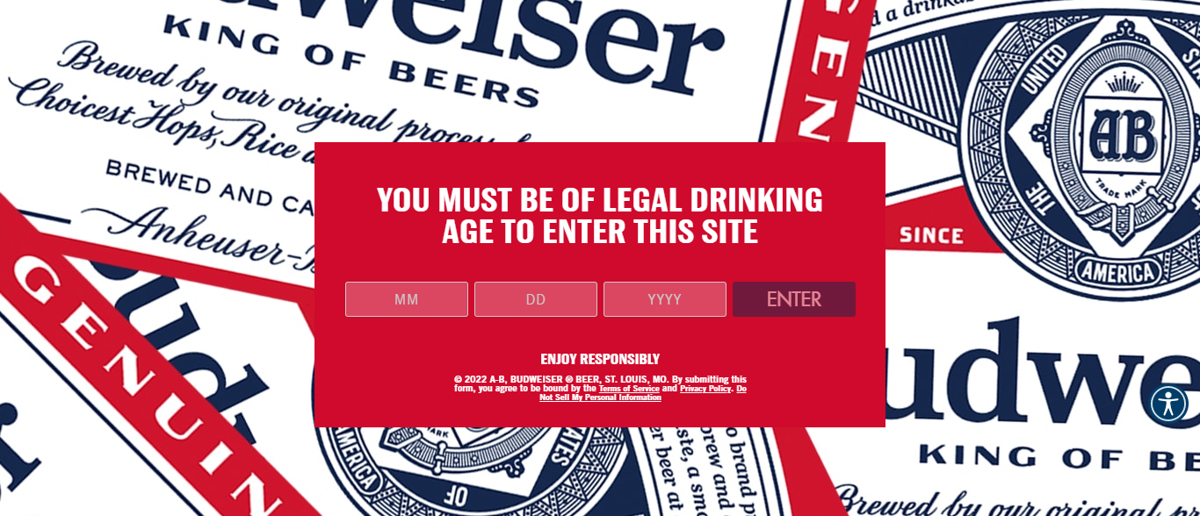
Exploratory Data Analysis

Slide 3
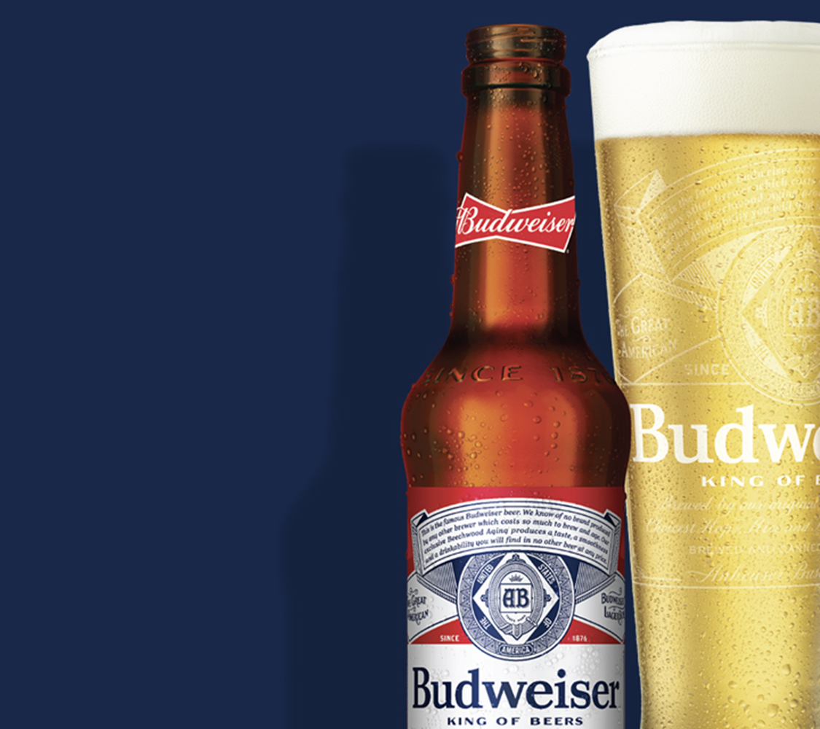
Introduction
Always Analytics was hired to investigate the data provided and gain insights into Budweiser’s questions of interest.
Initially, the data was split across 2 tables:
Beers contains a list of 2,410 U.S. craft beers with 7 variables:
Breweries consists of 558 U.S. breweries with 4 variables:
Data Description
Variable | Description
Name | name of beer
Beer ID | unique identifier of the beer
ABV | alcohol by volume of the beer
IBU | International Bitterness Units of the beer
Brewery ID | brewery id associated with the beer
Style | style of the beer
Ounces | ounces of beer
Variable | Description
Brew ID | unique identifier of the brewery
Name | name of the brewery
City | city where the brewery is located
State | U.S. state where the brewery is located

Slide 4
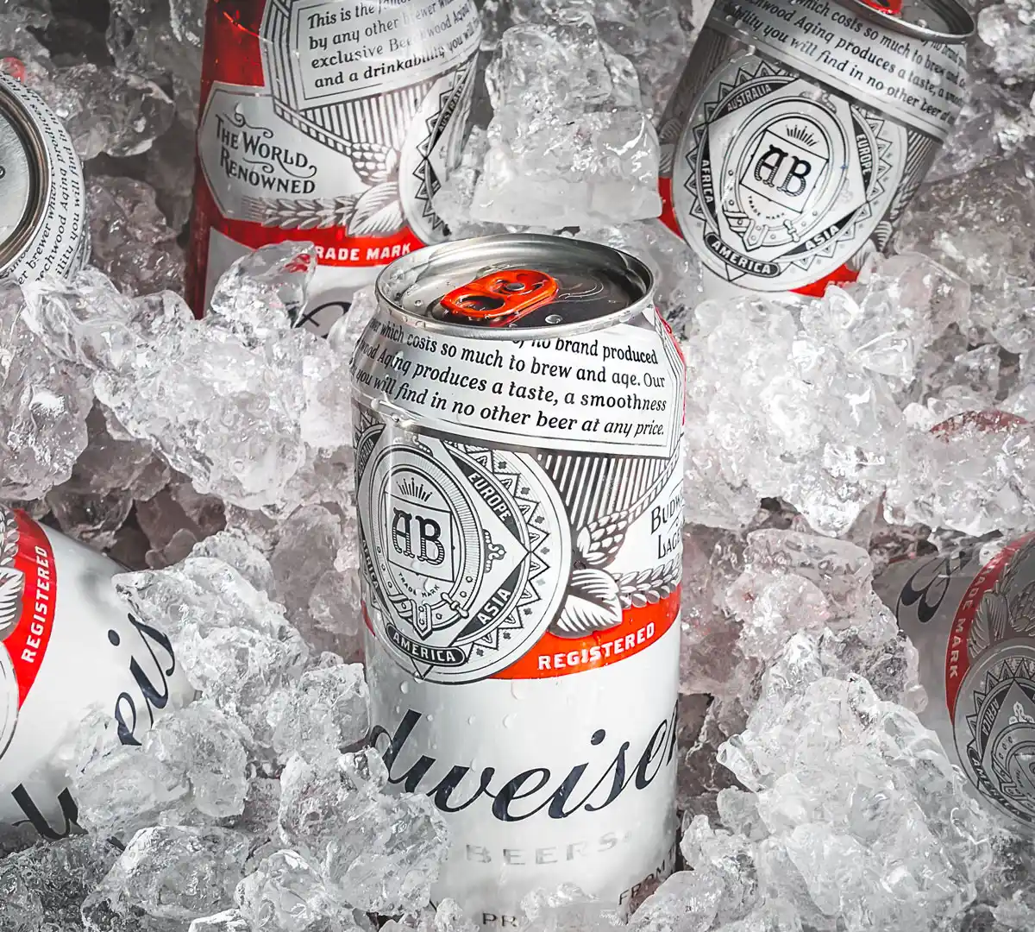
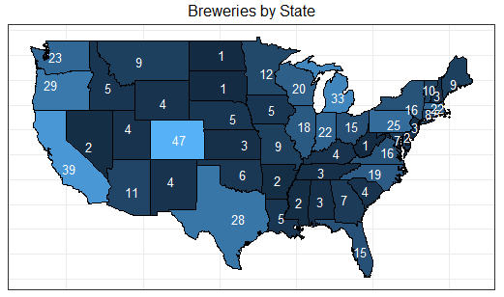
Question of Interest: How many breweries per state?
Top 5
Colorado | 47
California | 39
Michigan | 32
Oregon | 29
Texas | 28
Bottom 5
Mississippi | 2
North Dakota | 1
West Virginia | 1
South Dakota | 1
DC | 1

Slide 5
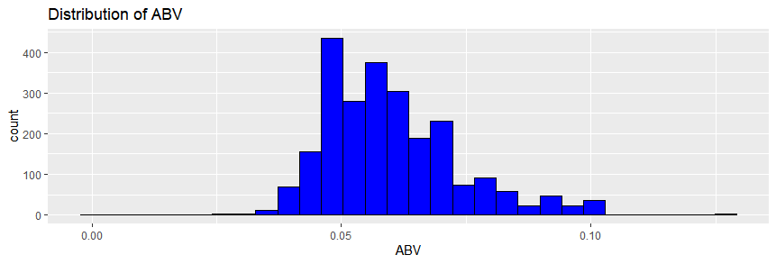
Question of Interest: ABV Summary statistics and distribution
The summary statistics for ABV indicate a tight interquartile range.
The range of this data set is between 0.1% and 12.8%.
In comparison, this aligns to the industry standard range where beers typically fall in the 3% to 13% ABV range.
The distribution for ABV appears normal with a moderate right skew.
Min | Q1 | Median | Mean | Q3 | Max
0.1% | 5.0% | 5.7% | 6.0% | 6.7% | 12.8%

Slide 6
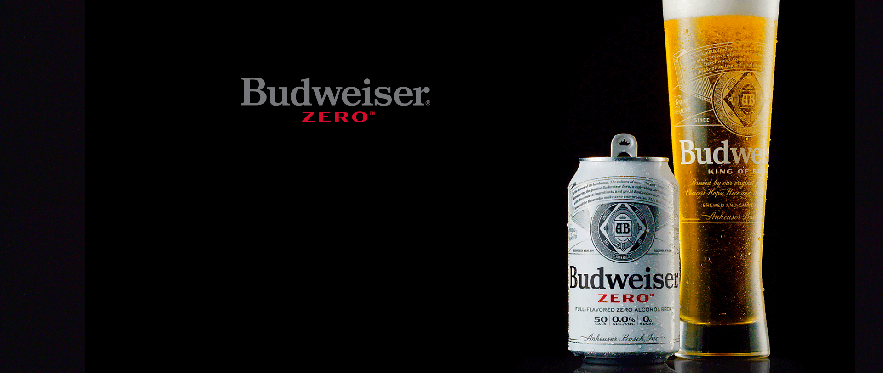
Question of Interest: How to address missing values?
Always Analytics identified 2 variables in the Beers data set that were missing information:
ABV was missing 62 observations
IBU was missing 1005
As discussed earlier, the summary statistics suggest high density clustered around the mean.
To avoid excluding nearly half (42%) of the data, the mean was used to replace the missing value.

Slide 7
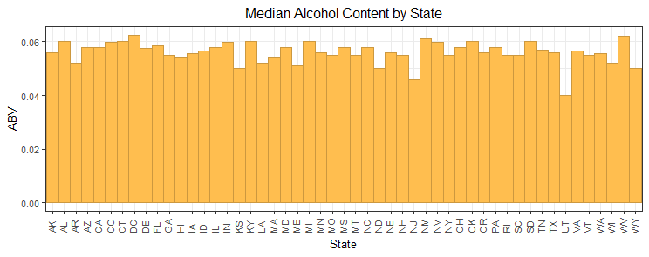
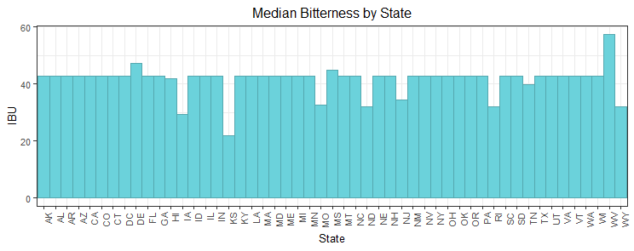
Question of Interest: What is the median ABV and IBU by state?
Most states have a median ABV between 5% to 6%.
NJ and UT are outliers with median ABV of 4.6% and 4% respectively.
Most states have a median IBU slightly above 4.
WV leads with median bitterness of 5.7
KS and IA have the lowest median bitterness at 22 IBUs and 29.5 IBUS respectively.
Notes:
Need to fix code for plot. Cannot pass this vector to ggplot. Tried setting as a df but only allowed to name the output median as a column. State has no header and could not set a 2nd variable name to df.

Slide 8
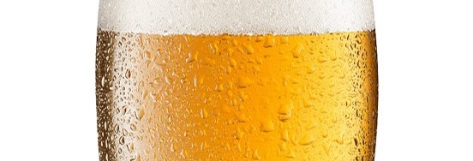
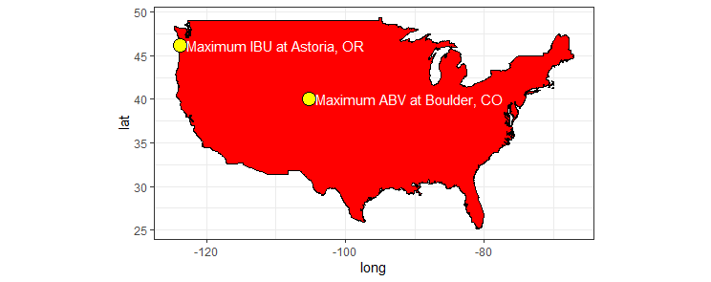

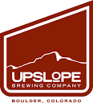
Question of Interest: Which state has the maximum ABV & IBU beer?
Upslope Brewing Company located in Boulder, Colorado has the max ABV.
Astoria Brewing Company located in Astoria, Oregon has the max IBU.

Slide 9

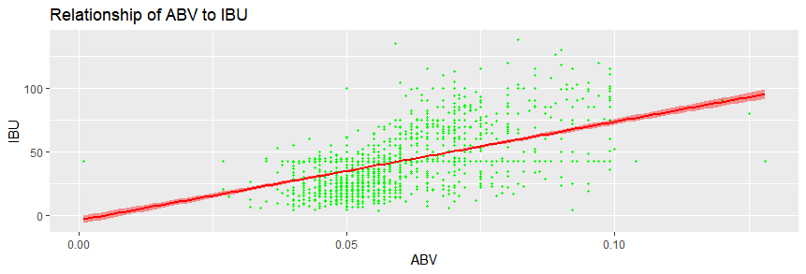
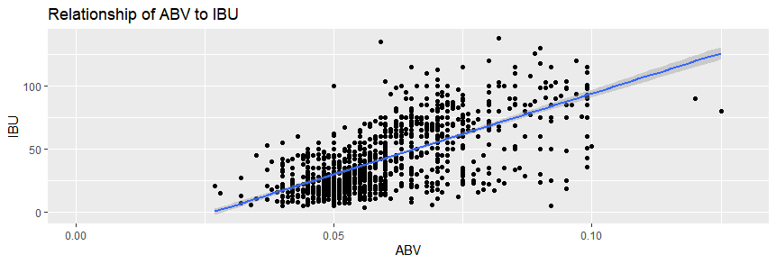
Question of Interest: Assess the relationship between IBU and ABV
The evidence suggests a positive linear relationship between bitterness (IBU) and ABV. A Pearson’s test indicates a moderate correlation of 0.52
Additional analysis is needed to determine if other variables are significant.
Always Analytics also examined the relationship between IBU and ABV for the data set missing values. Recall, in this case, the mean was not used to fill in the blanks.
Now, the correlation test yields a higher score of 0.67 which proves the impact of the missing data.

Slide 10
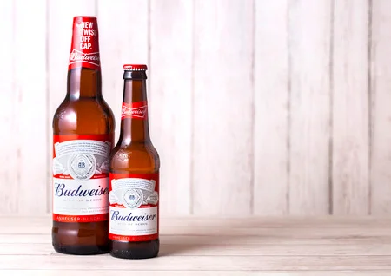
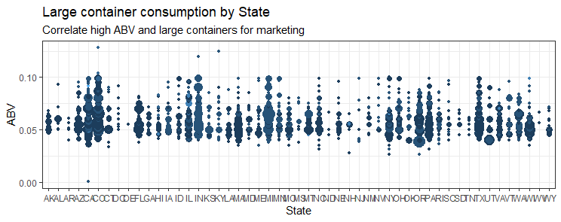
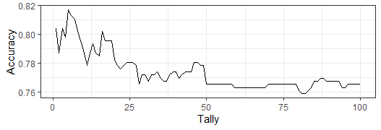

QOI: Investigate difference between IBU and ABV with respect to IPAs and Ales
To take advantage of the microbrewery market, Always Analytics’ recommendation is for Budweiser to begin in the Colorado and West Coast markets, due to the clear popularity of craft brews there (as noted on slide 2).
In conclusion, Always Analytics achieved an 82% accuracy rate when predicting whether a beer was IPA or an Ale based on the IBU and ABV, (95% confidence internal between 78% and 85%).
The evidence suggests ABV and IBU are useful to predict Ale vs. IPA. The prediction model yielded a high sensitivity rate of 87% (true positives) and a specificity rate of 74% (true negatives).
Best accuracy prediction attained using 5 parameters

Slide 11



Questions?
Contact Always Analytics:
April Erby
aerby@mail.smu.edu
Nicole Assenza
nassenza@mail.smu.edu
Adam Vuinovic avuinovic@mail.smu.edu

